Slide 1

Dr.Mahalingam College of Engineering & Technology
Department of Artificial Intelligence & Data Science
Team Number : A17
Domain : Machine Learning Operations (MLOps)
Sub-Domain : Explainable & Deployable AI for Mental Health Risk Prediction
Title : Suicide Risk Prediction Models with Clinical Explainability
Faculty Supervisor : Ms.M. RAJALAKSHMI
Team Members : Maha mathesh raja B (727624BAD031)
irfan basha R (727624BAD009)
Sridhar M (727624BAD091)

Slide 2
.
Abstract:
Over 300 million people worldwide are affected by depression, with symptoms that have a major impact on patients and, in the worst cases, can lead to suicide.
As the severity of the disease increases over time, early detection can save a patient’s life. The disease is diagnosed by professionals using questionnaires that might be influenced by biases, and of which the accuracy and reliability are not guaranteed.
Due to the low level of preprocessing and the associated fast computing time and low computational intensity, our innovative approach can serve as a basis for applications in the real world. This enables patients with suitable hardware to recognize the disease themselves at an early stage and thus receive timely treatment to prevent further development.
However, the focus is not on the early detection of mild depression, which can be the entry point to major depression. In this work, we developed a deep learning based model using a 1D convolutional neural network to detect mild depression in resting-state electroencephalogram data. We evaluated the model using a realistic world-like dataset and were able to achieve a balanced accuracy of 69.21%

Slide 3
Project Improvements & Key Innovations
Before (Baseline):
Black-box BERT models with high accuracy but no transparency, minimal deployment readiness, and limited clinical trust.
Current Improvements:
Systematic reverse engineering of fine-tuned BERT/MentalBERT models to uncover learned linguistic/emotional patterns (hopelessness, urgency, isolation).
Implementing SHAP attributions, attention visualization, and probing to understand model internals.
Laying foundations for MLOps (tracking, basic versioning).
Starting model compression for on-device inference.
Early bias audits and ethical/privacy reviews.
Progress toward cross-platform deployment.
Impact So Far:
Better model understanding, initial explainability, and a clearer path to responsible deployment.
Interpreting complex attention patterns in transformer layers
Deployment Direction:
TensorFlow Lite, ONNX

Slide 4
Technical Stack & Algorithms
Core Models:
BERT-base-uncased, MentalBERT (fine-tuned on UMD/CLPsych datasets)
Reverse Engineering Techniques:
SHAP (KernelSHAP for token importance).
Attention visualization (BertViz).
Probing experiments on hidden layers.
Current Tools:
Python + Hugging Face Transformers.
Basic scripts (main.py, model.py, pipeline.py).
Early MLOps: MLflow/Optuna explorations.
Algorithms in Focus:
Token attribution, attention analysis, quantization/pruning.
Concept Activation Vectors (TCAV), Early experiments to measure alignment between model activations and clinical concepts

Slide 5
Dataset Details
Source:
UMD Reddit Suicidality Dataset and CLPsych Shared Task corpus (clinician-annotated, de-identified Reddit posts).
Size:
~500 users / ~11,000 posts across risk categories (No Risk, Low, Moderate, Severe, Attempt), per CLPsych 2019 annotation scheme.
Features:
Raw post text, timestamp, subreddit metadata, and derived linguistic features (LIWC categories, sentiment scores, n-grams) used alongside BERT embeddings.
Preprocessing:
De-identification, tokenization (WordPiece), removal of moderator/bot posts, class-imbalance handling via stratified sampling, and train/validation/test splits by user (not by post) to avoid leakage.
Relevance to Proposed Work:
Provides the clinically-annotated ground truth needed to validate that reverse-engineered model signals (hopelessness, urgency, isolation) align with real clinical risk levels.

Slide 6
Project State – Before vs. Current
Before state of the project:
Basic prediction scripts.
Raw risk scores with no explanations.
No auditing or compression.
Desktop-only, privacy risks.
Current state of the project(version 0):
Reverse-engineered insights into model behavior.
Initial SHAP-highlighted explanations.
Versioned pipeline improvements .
Early on-device readiness and XAI integration.
Better understanding and auditability.

Slide 7
Loopholes/Gaps – Before vs. Current
Before:
Opaque black-box decisions (low trust).
No explainability or clinical alignment.
Deployment and privacy issues.
Unaddressed biases and robustness gaps.
Current:
Addressed: Initial transparency via SHAP/attention; better pattern understanding; privacy foundations.
Remaining Loopholes: Full MLOps not complete, comprehensive clinical validation pending, multimodal expansion needed, full cross-platform testing ongoing.
Overall: Significant reduction in opacity; stronger foundation for responsible AI.

Slide 8
Challenges, Lessons & Roadmap Ahead
Challenges in Reverse Engineering So Far:
Interpreting complex attention patterns in transformer layers.
Balancing model compression with accuracy retention.
Handling dataset biases (Reddit-heavy data vs. clinical diversity).
Computational constraints during probing/SHAP on large models.
Ethical navigation (sensitive mental health domain).
Key Lessons Learned:
Reverse engineering reveals clinically meaningful signals even without explicit training.
Early XAI integration saves time in later validation.
Version control and modular code are essential.
On-device focus forces efficient, privacy-first design from the start.

Slide 9
Challenges, Lessons & Roadmap Ahead
Next Steps for improving:
Complete full MLOps pipeline and CI/CD.
Expand to multimodal (text + EEG if available).
Larger clinician feedback loop for explanations.
Full cross-platform testing and adversarial robustness hardening.
Prepare for conference submission with quantitative benchmarks.
Plan of Implementation in the Operating System:
Use eBPF + kprobes as the Core Engine (Safe, powerful, and production-grade)
Use inotify or D-Bus to watch specific allowed directories/files (with permission)
Rate limiting on monitoring.
Kill switch and audit logs for the user.

Slide 10
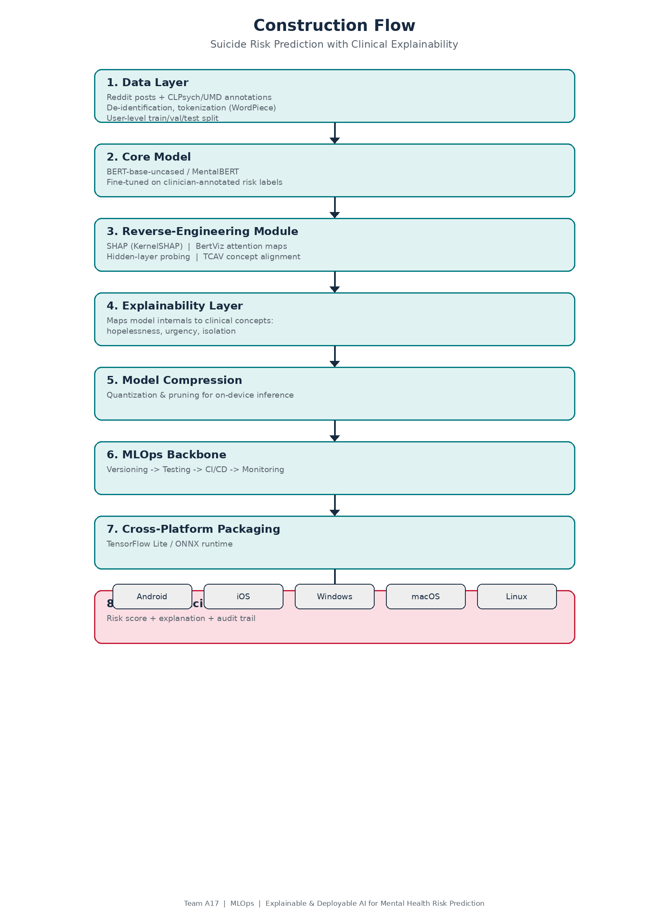
Construction Flow

Slide 11
Literature Survey
Pascal Penava et al.(2025)—Early-Stage Non-Severe Depression Detection Using a Novel CNN Approach on Resting-State EEG Data (2024) — IEEE.
Ji et al. (2021) — Review of machine learning methods for suicidal ideation detection.
Ophir et al. (2020) — Deep neural networks applied to Facebook posts for risk detection.
Tadesse et al. (2020) — Deep learning approaches on social media forums.
Gaur et al. (2019) — Knowledge-aware severity assessment of suicidal ideation.
Coppersmith et al. (2018) — NLP of social media for suicide risk screening.
Lundberg & Lee (2017) — SHAP: A unified approach to interpreting model predictions.
Ribeiro et al. (2016) — LIME: Explaining the predictions of any classifier.

Slide 12
References
Book References:
Molnar, C. (2022). Interpretable Machine Learning: A Guide for Making Black Box Models Explainable (2nd ed.). independently published.
Web References:
Pascal Penava et al.(2025) — Early-Stage Non-Severe Depression Detection Using a Novel CNN Approach on Resting-State EEG Data — https://ieeexplore.ieee.org/document/10757418
Coppersmith et al. (2018) — https://journals.sagepub.com/doi/full/10.1177/1178222618792860
Ji et al. (2021) — https://ieeexplore.ieee.org/document/9199553

Slide 13
THANK YOU

